Slide 1
Ludo Game
Building Multiple Functionality for Ludo Gaming

Slide 2
Name: Makmudul Hasan Rabbi
Student ID: ASH2125008M
Year : 02 , Term : 01
Mail: rabbi2516@student.nstu.edu.bd

Slide 3
INTRODUCTION
Brief overview of Ludo game
Importance of multiplayer functionality
How Ludo Transcends the Board
Evolution of Board Games into Digital Formats

Slide 4
OVERVIEW
Explain Ludo game rules and objectives
Highlight the need for real-time interaction among players
Mention benefits of multiplayer experience

Slide 5
IMPLEMENTATION
Game Logic and Rules Implementation
Board Representation and Data Structures
Randomization and Dice Roll
Player Interaction and Turns
Game Progression and Winning Conditions

Slide 6
Multiplayer Implementation
Explain how multiple players are managed
Turn-Based Gameplay in Multiplayer
Multiplayer Challenges and Achievements

Slide 7
Challenges
Development Challenges
Overcoming Challenges
Local Multiplayer Design
Turn Management and Fairness

Slide 8
Features
Multiplayer Gameplay
Turn-Based System
Dice Roll Simulation
Gameplay Logic
Error Handling

Slide 9



Languages & Tools
JAVA
VS Code
CMD

Slide 10

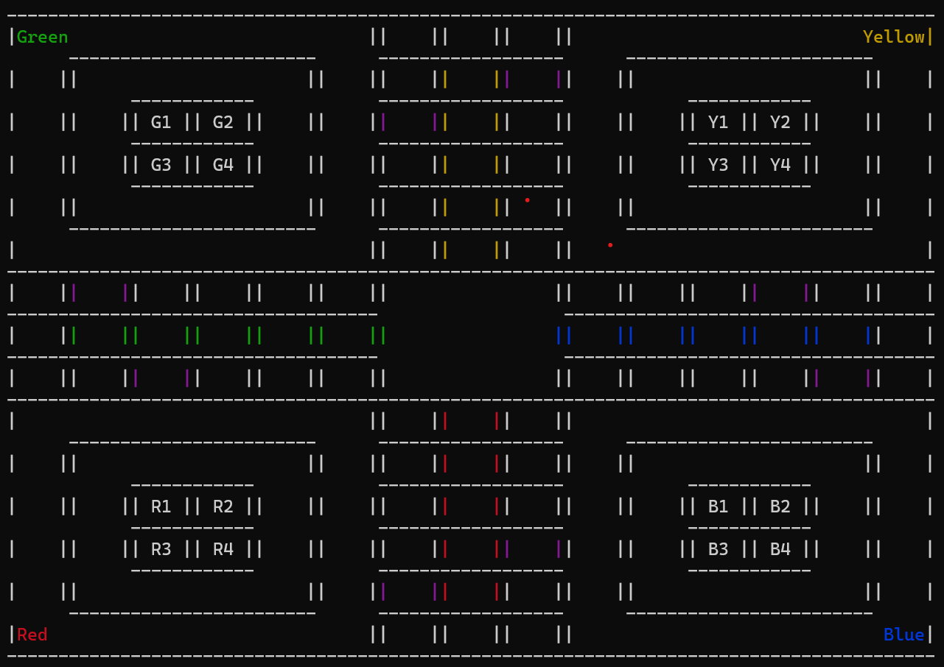
ANY QUESTION
ANY QUESTION

Slide 11
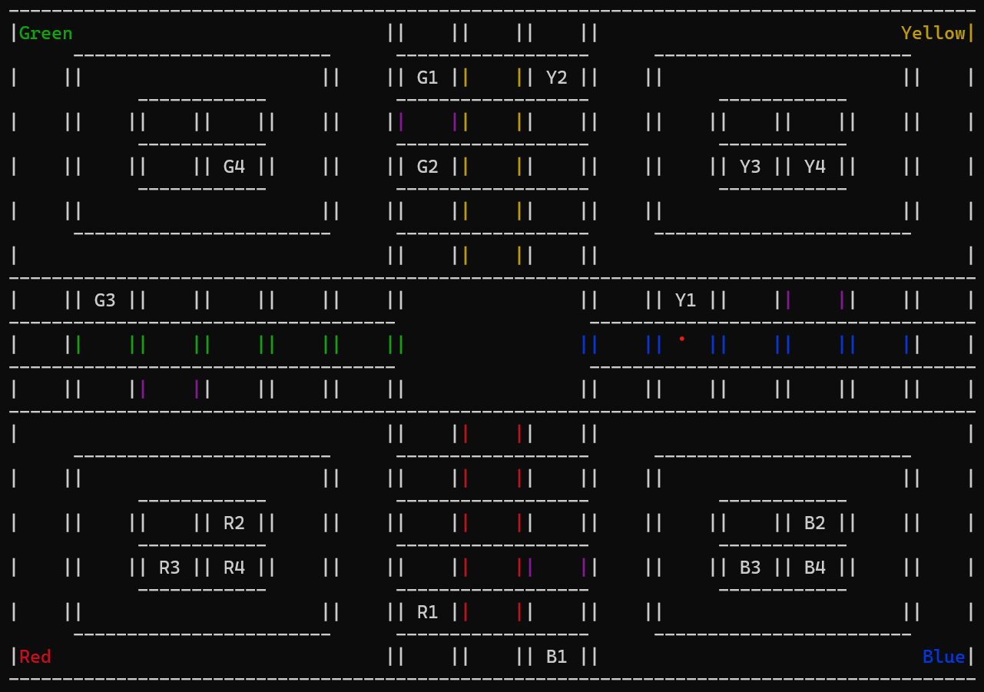
ANY QUESTION
ANY QUESTION

Slide 12
ANY QUESTION
ANY QUESTION

Slide 13
THANK YOU!

